Slide 1
ECO525 Managerial Economics

Slide 2
Learning Objectives
Define and measure elasticity
Apply the concepts of price elasticity, cross-elasticity, and income elasticity
Understand the determinants of elasticity
Show how elasticity affects revenue

Slide 3
The Economic Concept of Elasticity
Elasticity: the percentage change in one variable relative to a percentage change in another.

Slide 4
Price Elasticity of Demand
Price elasticity of demand: the percentage change in quantity demanded divided by the percentage change in price
Notes:
Elasticity is fundamental to business decisions. With all the price changes in retail, it is necessary to forecast the effects on sales and revenues.

Slide 5
Price Elasticity of Demand
Arc price elasticity: elasticity which is measured over a discrete interval of the demand curve
E_{p} = arc price elasticity
Q₁ = original quantity demanded
Q₂ = new quantity demanded
P₁ = original price
P₂ = new price
Notes:
To some students with little math background, this may seem like a complicated equation. But is just uses average quantities and prices to calculate the percentage changes.

Slide 6
Price Elasticity of Demand
Point elasticity: elasticity measured at a given point of a demand (or supply) curve. Instead of estimating over a range of prices, it is the elasticity at a specific price. The point elasticity of a linear demand function can be expressed as:
Notes:
Point elasticity might need a little extra explanation. Arc elasticity provides and average elasticity over a range of prices, but the calculation of point elasticity provides the specific elasticity at a price.

Slide 7
Price Elasticity of Demand
When demand is nonlinear, the calculation of ΔQ/ΔP is somewhat more complicated because the slope of a curve changes. This slope is obtained using the calculus concept of derivative. In this instance,
Ed= dQ/dP * P1/Q1
The derivative of Q with respect to P (i.e., dQ/dP) is simply the instantaneous version of slope.

Slide 8
Price Elasticity of Demand
An example of a nonlinear demand curves is one with constant elasticity
such a curve has a nonlinear equation:
Q = aP^{-b}
where –b is the elasticity coefficient

Slide 9
Price Elasticity of Demand
Categories of elasticity
Relative elasticity of demand: E_{p} > 1
Relative inelasticity of demand: 0 < E_{p} < 1
Unitary elasticity of demand: E_{p} = 1
Perfect elasticity: E_{p} = ∞
Perfect inelasticity: E_{p} = 0

Slide 10
Price Elasticity of Demand
Factors affecting demand elasticity
ease of substitution
proportion of total expenditures
length of time period
durability of product
possibility of postponing purchase
possibility of repair
used product market

Slide 11
Price Elasticity of Demand
Derived demand: the demand for items that go into the production of a final commodity, such as materials, machinery, and labor.
The demand for such components of a final product is called derived demand.
The demand for such a product or factor exists because there is demand for the final product.
Notes:
This is an important business concept-it helps explain why some occupations pay much more than others.

Slide 12
Price Elasticity of Demand
The derived demand curve will be more inelastic:
the more essential is the component
the more inelastic is the demand curve for the final product
the smaller is the fraction of total cost going to this component
the more inelastic is the supply curve of cooperating factors

Slide 13
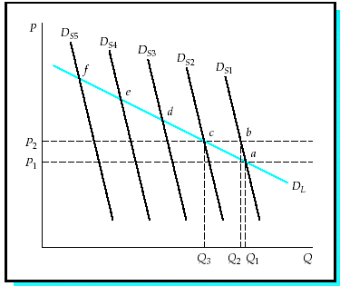
Price Elasticity of Demand
Short Run vs. Long Run
A long-run demand curve will generally be more elastic than a short-run curve.
As the time period lengthens consumers find ways to adjust to the price change, via substitution or shifting consumption.
Notes:
A good discussion on long run elasticity is the change in our choices of transportation as the costs of transportation have changed.

Slide 14
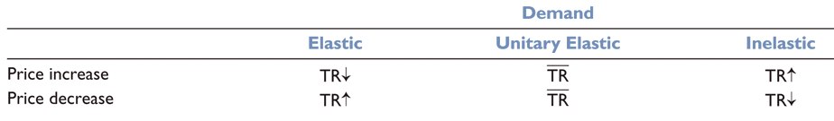
Price Elasticity of Demand
The relationship between price and revenue depends on elasticity

Slide 15
Price Elasticity of Demand
Marginal revenue: the change in total revenue resulting from changing quantity by one unit

Slide 16
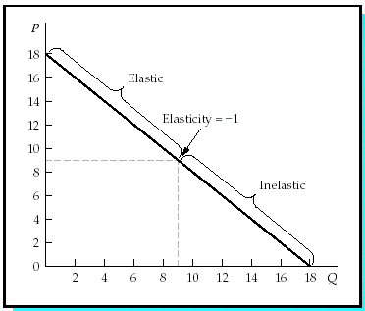
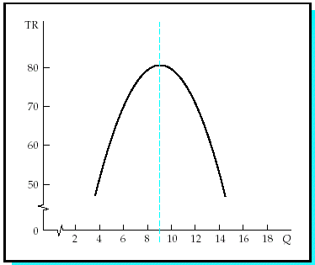
Price Elasticity of Demand
As price decreases
revenue rises when demand is elastic
revenue falls when it is inelastic
revenue reaches its peak if elasticity =1
The lower chart shows the effect of elasticity on total revenue.
Notes:
One of the points to make on this slide is that, although elasticity is very important for pricing, businesses strive to maximize profits and not revenue.

Slide 17
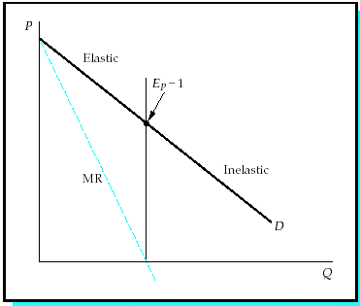
Price Elasticity of Demand
Marginal revenue curve is twice as steep as the demand curve

Slide 18
Price Elasticity of Demand
At the point where marginal revenue crosses the X-axis, the demand curve is unitary elastic and total revenue reaches a maximum.

Slide 19
Price Elasticity of Demand
Elasticity examples
coffee: short run -0.2, long run -0.33
kitchen and household appliances: -0.63
meals at restaurants: -2.27
airline travel in U.S.: -1.98
U.S. oil demand: short run -.06, long run -.45

Slide 20
Cross-price Elasticity of Demand
Cross-price elasticity of demand: the percentage change in quantity consumed of one product as a result of a 1 percent change in the price of a related product
Notes:
The calculation of cross a elasticity helps business decision makers understand the effects of competitive prices on sales.

Slide 21
Cross-price Elasticity of Demand
Arc cross-elasticity-relates the percentage change in quantity to the percentage change in the price of another product (either a substitute or a complement).

Slide 22
Cross-price Elasticity of Demand
The sign of cross-elasticity for substitutes is positive
The sign of cross-elasticity for complements is negative.
Two products are considered good substitutes or complements when the coefficient is larger than 0.5 (in ab. value).

Slide 23
Cross-price Elasticity of Demand
Cross-price elasticity of demand examples:
Residential demand for electric energy with respect to prices of gas energy was low, about +0.13.
The cross-elasticity of demand for beef with respect to pork prices was calculated to be about +0.25. With respect to prices of chicken, it was about +0.12. Both numbers indicate that the products are substitutes.

Slide 24
Income Elasticity
Income elasticity of demand: the percentage change in quantity demanded caused by a 1 percent change in income
(Y is shorthand for income)
Notes:
This concept is particularly important during periods of change in incomes, such as recessions.

Slide 25
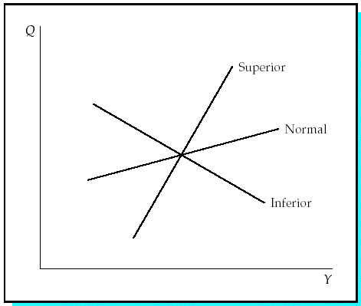
Income Elasticity
Categories of income elasticity
superior goods: E_{Y} > 1
normal goods: 0 ≤ E_{Y} ≤ 1
inferior goods: E_{Y} < 0

Slide 26
Income Elasticity
Income elasticity examples
Short-run income elasticity for food expenditure is about 0.5 and the elasticity of restaurant meals 1.6.
The short-run income elasticity for jewelry and watches appeared to be 1.0, long run is 1.6.
For gasoline the short-run income elasticity is between 0.35 and 0.55, long run between 1.1 and 1.3.

Slide 27
Other Demand Elasticity
Elasticity is encountered every time a change in some variable affects demand such as:
advertising expenditures
interest rates
population size

Slide 28
Elasticity of Supply
Price elasticity of supply: the percentage change in quantity supplied as a result of a 1 percent change in price
The coefficient of supply elasticity is a normally a positive number

Slide 29
Elasticity of Supply
When the supply curve is more elastic, the effect of a change in demand will be greater on quantity than on the price of the product
When the supply curve is less elastic, a change in demand will have a greater effect on price than on quantity

Slide 30
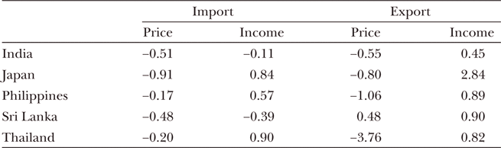
Global Application
There are substantial differences in elasticities around the world.
Notes:
This is a good discussion item on differences in elasticity due to different economic and cultural conditions.

Slide 31
Summary
Elasticity is defined as the sensitivity of one variable to another.
Price elasticity of demand is the percentage change in the quantity demanded of a product caused by a percentage change in its own price.
When demand is elastic, revenue rises as quantity demanded increases; revenue reaches its peak at the point of unitary elasticity and descends as quantity rises on the demand curve’s inelastic sector.
Cross-price elasticity, the relationship between the demand for one product and the price of another.
Income elasticity, measures the sensitivity of demand for a product to changes in the income of the population.

